Slide 1
Page Object Model
By Devul

Slide 2
What is Page Object Model?
Page object is a design pattern that is popular in test automation.
The advantage of this model is that it reduces code duplication and improves test maintenance. Additionally, a big benefit is that if the UI changes for the page, the test themselves don’t need to change, only the code within the page object needs to change.
It models areas of UI that can also be considered as object repository for web UI elements.
Functionality classes (PageObjects) in this design represent a logical relationship between the pages of the application.
Each class is referred to as PageObjects and returns other PageObjects to facilitate flow between pages.
Page object class is responsible to find the WebElements of that page and also hold methods which perform operations on those WebElements.

Slide 3
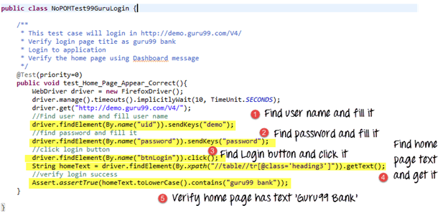
Why Page Object Model?
In scripts such as to the one on the left, we are simply finding elements and filling values for those elements.
The main problem with scripts is that if 10 different scripts are using the same element, any change to that element will require you to change all 10 scripts → Time consuming and error prone.
Better approach is to create a separate class file which would find web elements, fill them or verify them. The class can be reused in all scripts using that element.
If there is a change in the web element, we need to simply make changes to that 1 class.

Slide 4
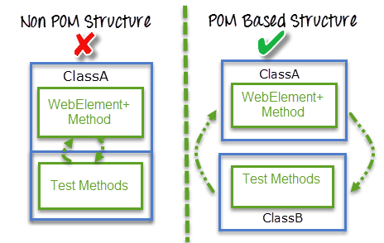
Advantages of POM
Page Object Design Pattern says operations and flows in the UI should be separated from verification. This concept makes our code cleaner and easy to understand.
Object repository is independent of test cases, so we can use the same object repository for a different purpose with different tools.
Less amount of code, and the code that is written is more optimized because of the reusable page methods in the POM classes.
There is a clean separation between test code and page specific code such as locators.
There is a single repositor for the services or operations offered by the page rather than having these services scattered through out the tests.

Slide 5
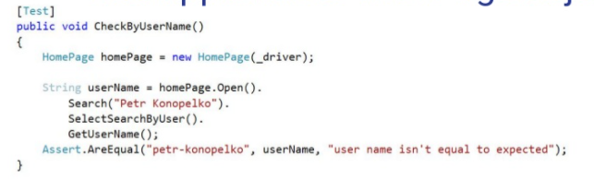
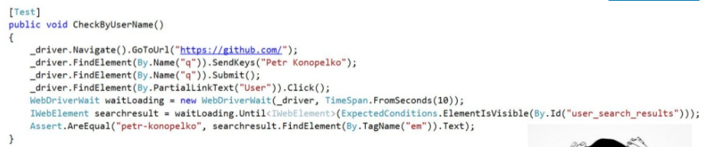
Scripts vs POP

Slide 6
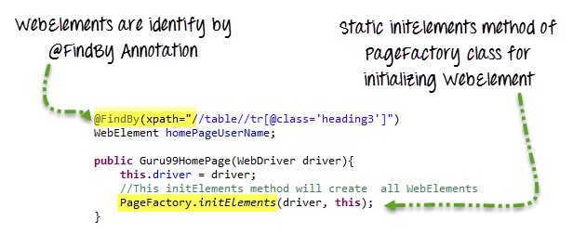
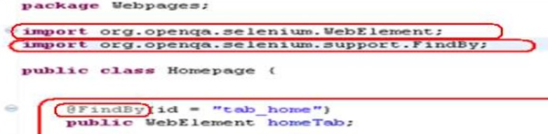
What is Page Factory in Selenium?
Page Factory in Selenium is an inbuilt Page Object Model framework concept for Selenium WebDriver, but it is very optimized.
It is used for initialization of Page objects or to instantiate the Page object itself. It is also used to initialize Page class elements without using "FindElement/s."
Here as well, we follow the concept of separation of Page Object Repository and Test Methods. Additionally, with the help of class PageFactory in Selenium, we use annotations such as @FindBy to find WebElement. We use initElements method to initialize web elements

Slide 7
Disadvantages of POP
There is no separation between the test method and the AUTs (Application Under Test) locators (for example IDs). Both are intertwined in a single method. If the AUT’s UI changes its identifiers, layout, or how a login is input or processed, the test itself must change.
The id-locators would be spread in multiple tests, all tests that had to use this login page.

